Slide 1
Data Refinement Lab Watson Studio 123

Slide 2
Basic flow for data refinement
In your Project select a data asset (Loan Status)which you want to work with
Preview the data and visually inspect the data to see if there are columns that are missing data, or have character data when you would expect numeric data.
If the data looks like it needs refinement then use the refinery to remove the bad data or convert it to something usable by using the out of the box Operations to cleanse or shape your data
Save and Run the flow just created
Inspect the resultant file to ensure all necessary refinements have been made

Slide 3
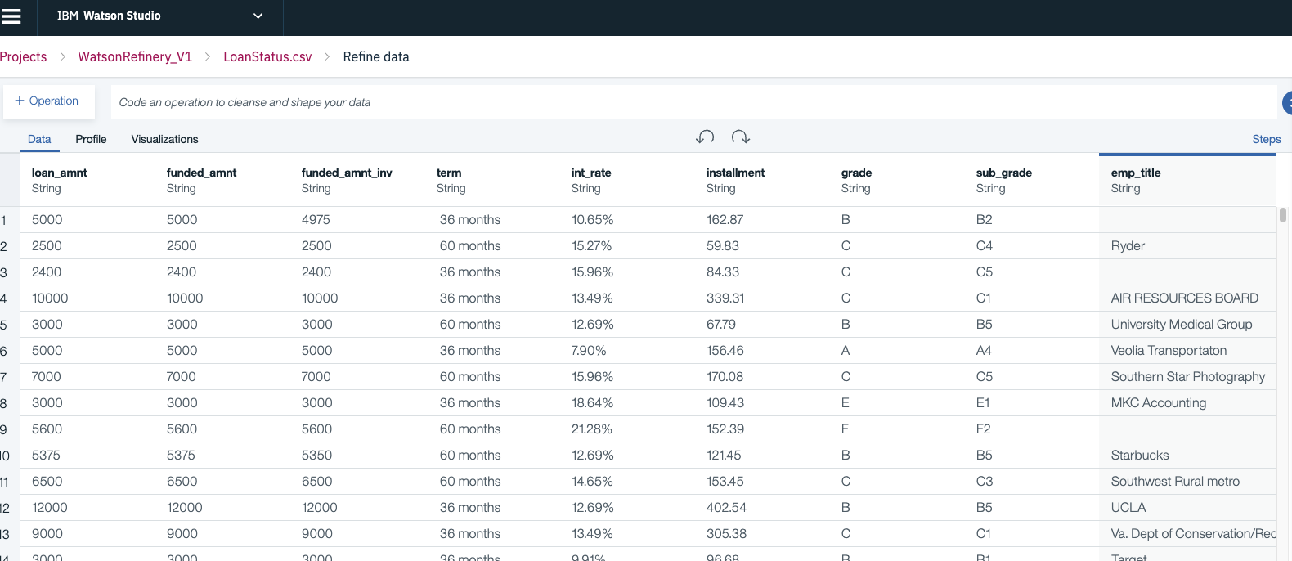
Data: LoanStatus.CSV
Let’s observe the quality of the data

Slide 4
Lab Session – Refine Data – Understand the baseline
Using the loan file provided the data scientist and data engineer have made the following observations:
Numeric Data
Task 1 : Term needs to be converted into an Integer, move “months”
Task 2: Int_rate needs the % removed
Task 3: Emp_length needs to be converted into an integer
Task 4: Home_ownership, Loan Status need to be turned into an integer
Task 5: Mths_since_last_delinq needs to be categorised
Categorical Data
Click on the Profile tab
View the categorical data to see what options there are
Term is either 36 months or 60 months
Emp_length ranges from < 1 year – 10+ years
Home_ownership is either RENT / MORTGAGE / OWN
Loan_Status is either Fully Paid / Charged Off
0 = isNull
1 = 49+ months
2 = 13 – 48 months
3 = 7 – 12 months
4 = 3 – 6 months
5 = 0 – 2 months

Slide 5
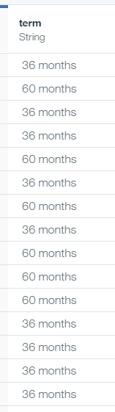
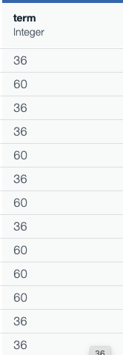
Lab Session – Refine Data Task 1 – Convert Term into an Integer
Remove “months” from the term String
Click on Operation
Under the Cleanse options select “Replace substring”
Select the “term” column and press next
Type in “ months” for the value (note the blank in front of months)
Click on replacement string, but leave blank
Click Apply
Convert into an Integer
Click on Operation
Under Frequently Used select “Convert column type”
There is no need to select a column because term is already selected
Select the type to be Integer
AS-IS
To-Be

Slide 6
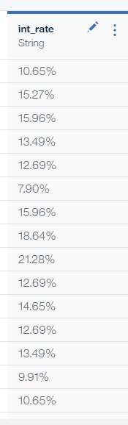
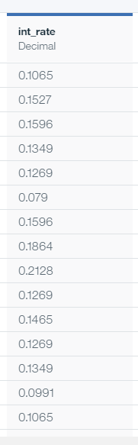
Lab Session – Refine Data Task 2 – Remove the % from interest rate and convert into a decimal between 0 and 1
Remove the % sign from the int_rate string
Click on Operation
Under the Cleanse options select “Replace substring”
Select “Change Column Selection” and select “int_rate” and press next
Type in % for the value and leave the replacement string blank
Convert into a decimal
Click on Operation
Under Frequently Used select “Convert column type”
Select Decimal and Apply
Divide by 100 to convert into a value between 0 and 1
Under Frequently Used select “Calculate”
Select the Division Operator
Type the value of 100 and press Apply
AS-IS
To-Be

Slide 7
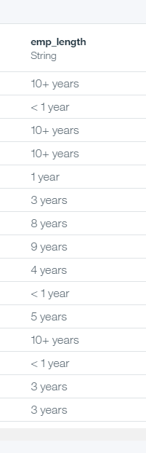
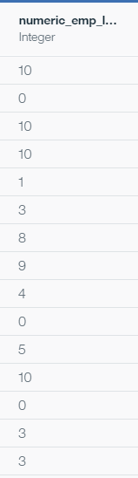
Lab Session – Refine Data Task 3 – Convert Emp_Length into a numeric categorical field
First we need to decide what to do with the “< 1 year” and “10+ year” values. There is a clear differentiation between “1 year” and “< 1 year” and so we might choose to set “<1 year” values to be 0. Conversely there is no “10 years” and the “10+ years” is a catch all, therefore we might decide to replace the “10+ years” with 10.
Derive a new field called numeric_emp_length
Remove years and year, + and < from the text
Click on Operation
Under the Cleanse options select “Replace substring”
Type in years for the value and leave the replacement string blank
Repeat and remove year
Repeat and remove +
Replace < 1 with 0
Convert numeric_emp_length into an Integer
AS-IS
To-Be

Slide 8
Lab Session – Refine Data Task 4 Convert Home Ownership into a categorical numeric
There are 3 different categories for home ownership
RENT
MORTGAGE
OWN
We need to create a separate numeric column for each of these values to represent the categories
HO_RENT
HO_MORTGAGE
HO_OWN
Where the HO_RENT column has a value of 1 in each row of the original column that contained the text RENT and a 0 for reach row that did not contain the text RENT. We will do the same for the MORTGAGE values and the OWN values placing them in the HO_MORTGAGE and HO_OWN columns respectively
➔ Steps on next slide
RENT
MORTAGE
OWN
HO_RENT
HO_MORTAGE
H0_OWN
0
1
1

Slide 9
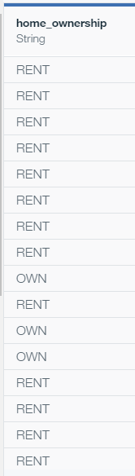
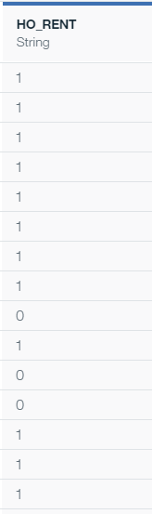
Lab Session – Refine Data Task 4 Convert Home Ownership into a categorical numeric - continued
Perform the following steps for each category
Click on Operation
Under the Organize options select “Conditional replace”
Select the column home_ownership and press next
Select “Is equal to” from the Contains drop down list
Type in RENT for the value
Type 1 for the Replace With
Click on “Add Condition”
Select “Is not equal to”
Type in RENT for the value
Type 0 for the Replace With
Scroll down to the bottom and select “Create new column for results”
Type in HO_RENT for the new column name and press apply
Convert the new column into an Integer
Repeat the process for the MORTGAGE and OWN categories
AS-IS
To-Be

Slide 10
Lab Session – Refine Data Task 5 – Manage missing data within Mths_since_last_delinq field
Let’s make the assumption that the recency of the delinquency is important and give more weight to borrowers who have been recently delinquent. Categorize the mths_since_last_delinq as follows:
0 = isNull
1 = 49+ months
2 = 13 – 48 months
3 = 7 – 12 months
4 = 3 – 6 months
5 = 0 – 2 months
Note: Some algorithms will use the size of the value as a factor in its analysis and that is why we are separating the isNull and the most recent delinquency values as far away from each other as possible

Slide 11
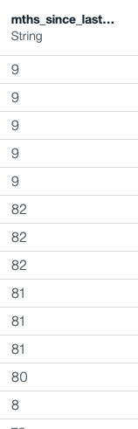
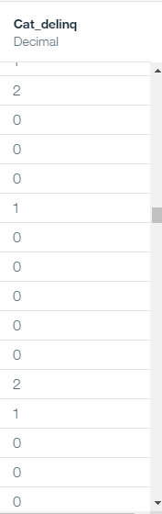
Lab Session – Refine Data Task 5 – Manage missing data within Mths_since_last_delinq field - continued
Convert the column into a decimal – the missing value routines does not appear to work on String in this case
Convert missing values into -99
Click on Operation
Under the Cleanse options select “Replace Missing Values”
Select the mths_since_last_delinq column
Type -99 for the value and press apply
Create a new column with categorized data
Click on Operation
Under the Organize options select “Conditional Replace”
For the operator select “Is equal to”
Set the value of -99
Set Replace With to 0
Press Add a Condition
Select Operator is greater than or equal
Set value = 49
Set Replace with = 1
Press Add a condition
Select Operator is between two numbers
Set value = 13,48
Add further conditions for the other ranges as detailed on previous slide
At the end check the “Create new column for results” box and name it cat_delinq
AS-IS
To-Be

Slide 12
Lab Session – Refine Data Task 6 – Create the output file to use in the Data Science Project
Prepare to generate the refined data file
Click on the Run icon to run the flow
Verify the name of the output file (do not overwrite the source file)
Click on Save and Run Flow
Execution status will be display

Slide 13
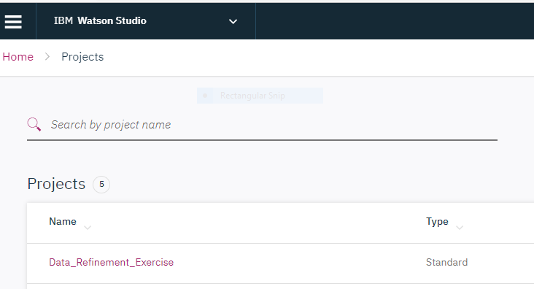
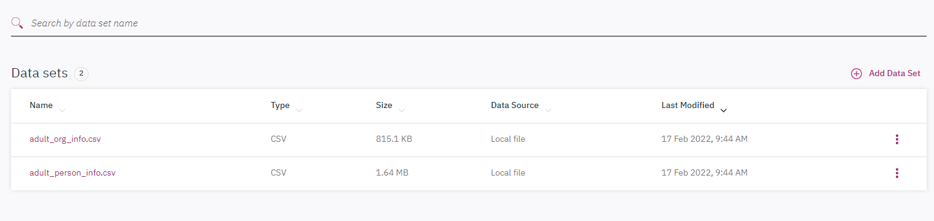
Exercise 1
Create a project:
Add dataset : <data adult_person_info.csv and adult_org_info.csv>

Slide 14
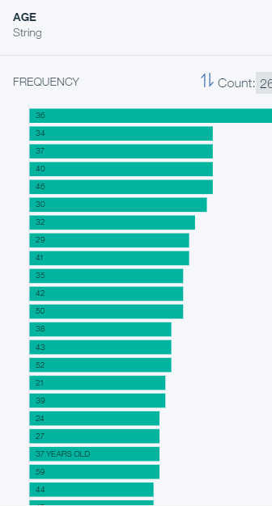
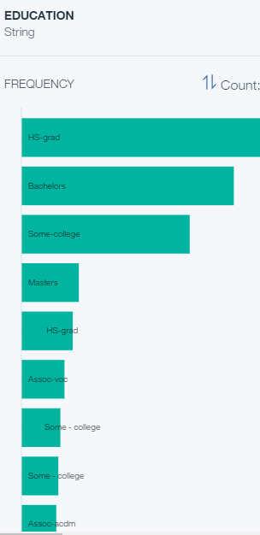
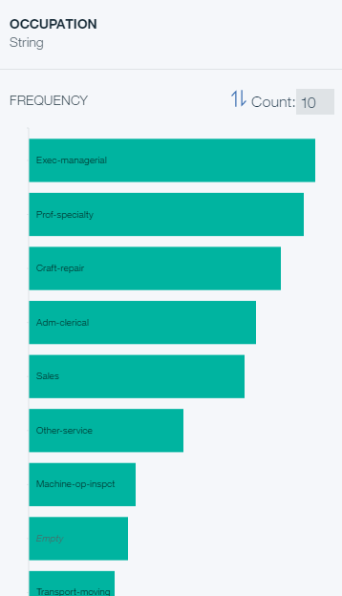
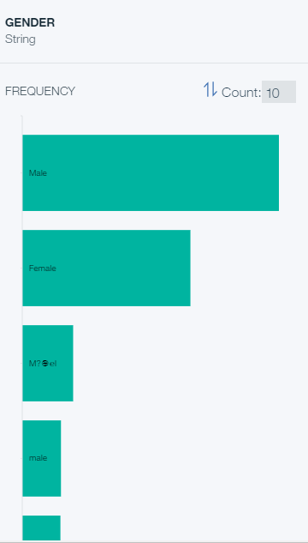
Review Data Profile
1
2
3
4
a. Some values under AGE contain additional string such as “years old”,
b. For Education, there are some additional values with extra spaces at the beginning and possibly the end of the string,
c. Empty cells in the OCCUPATION column,
d. and there are multiple values under GENDER that seem to be meant to represent the value Male, etc.

Slide 15
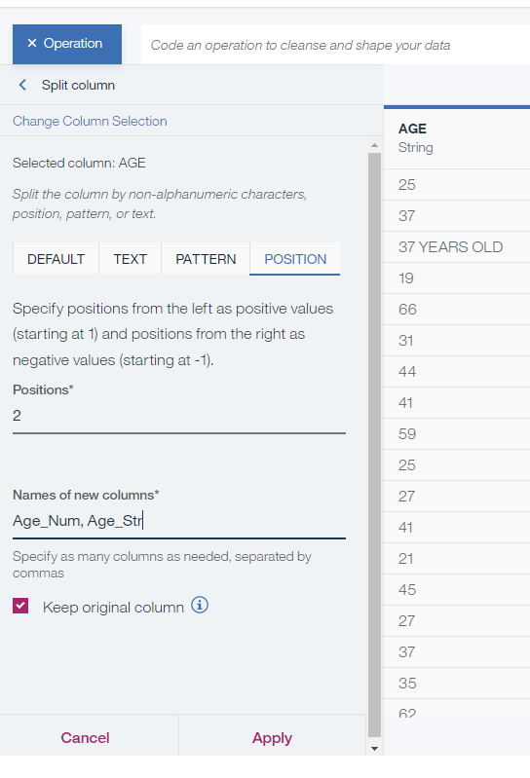
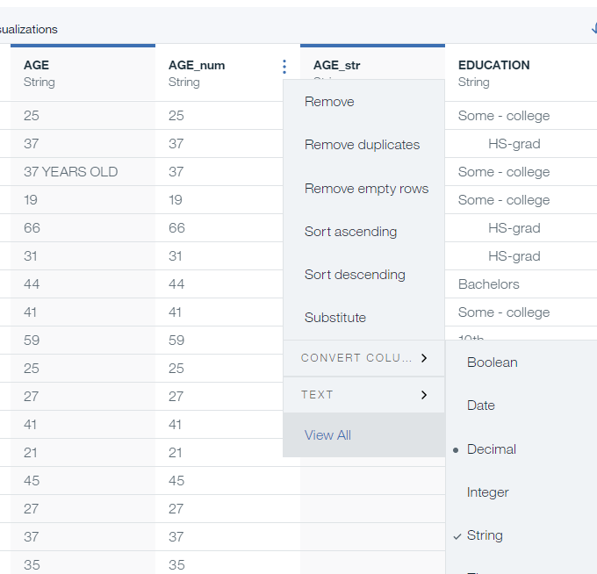
Data Harmonization: Age
Objective: standardise AGE field
Step:
Click on +Operation and select Split column, which you can find under ORGANIZE.
Choose AGE as the Selected column.
Under POSITION tab, type 2 in the Positions field and <AGE_num,AGE_str> in the Names of new columns. Make sure to unselect Keep original column
Click Apply.
Change AGE data type to Integer by clicking on the triple dots, then CONVERT COLUMN…> Integer. Data Refinery will put a dot in front of the recommended data type.

Slide 16
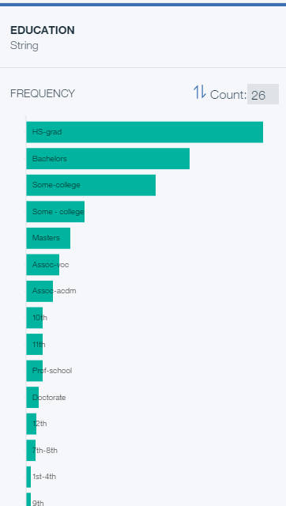
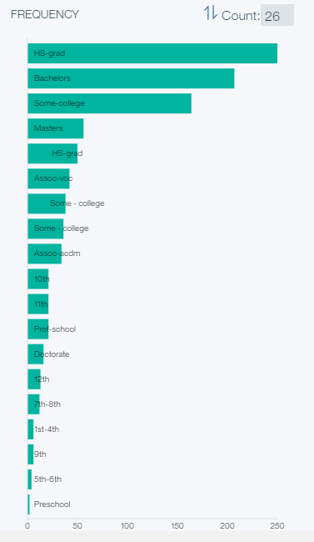
Data Harmonization: Education
Objective : Education
Remove space-> Standardise wording->
Step 1 :
Click on +Operation and select Text, which you can find under FREQUENTLY USED.
Choose EDUCATION as the Selected column, Collapse spaces as the Text Operation.
Click Apply and go to the Profile tab again to check if all the additional values have been removing. You will notice the we still have Some - college as an additional value, which we want to harmonize and change to Some-college.

Slide 17
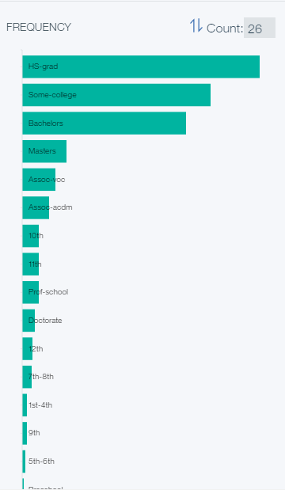
Data Harmonization: Education
Objective : Education
Remove space-> Standardise wording->
Step 2 :
Click on +Operation and select Replace substring, which you can find under CLEANSE.
Choose EDUCATION as the Selected column.
Under TEXT tab, type Some - college in Value field and Some-college in the Enter the replacement string. Make sure to select Replace all occurrences
Click Apply.

Slide 18
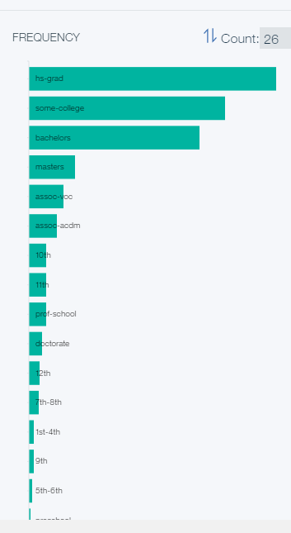
Data Harmonization: Education
Objective : Education
Remove space-> Standardise wording->lower case
Step 2 :
We also want to convert all values in the EDUCATION column to lower case. So, click on +Operation and select Text, which you can find under FREQUENTLY USED.
Choose EDUCATION as the Selected column, Lower case as the Text Operation.
Click Apply and go to the Profile tab again to for a final check.

Slide 19
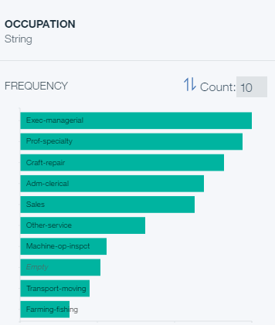
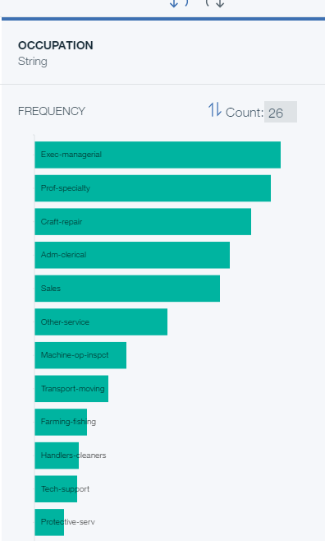
Data Harmonization: OCCUPATION
Objective: Removing empty rows
Step:
Go to the Data tab.
Go to the column called OCCUPATION and remove rows with any empty values by clicking on the triple dot menu next to the column name and selecting Remove empty rows.

Slide 20
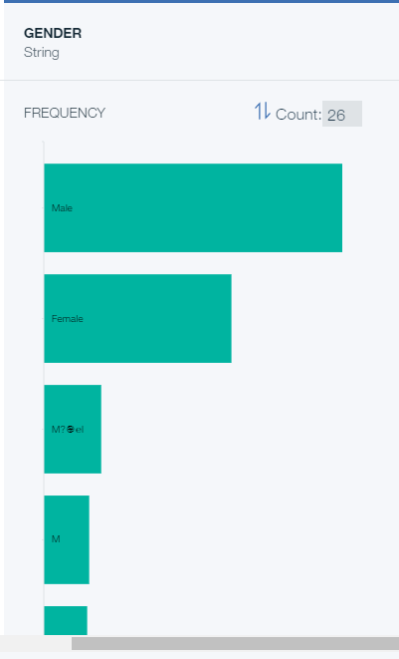
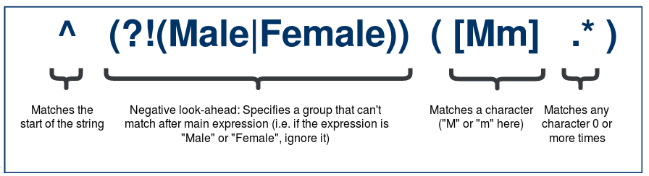
Data Harmonization: GENDER
Objective: Standardize the GENDER field:
Step:
Click on +Operation and select Replace substring, which you can find under CLEANSE.
Choose GENDER as the Selected column.
Under PATTERN tab, type <^(?!(Male|Female))([Mm].)> in the Regular expression field and Male under Enter the replacement string. Make sure to select Replace all occurrences.

Slide 21
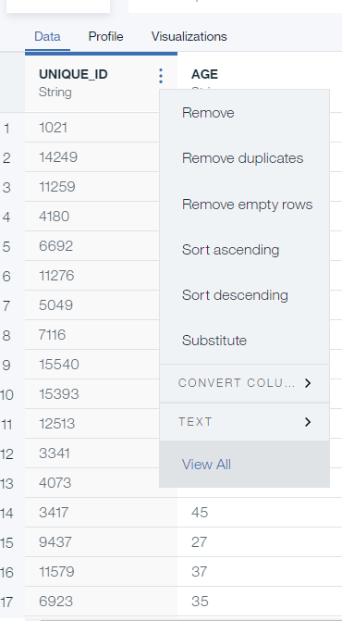
Data Harmonization: Unique ID
Objective: remove Duplicate
Step:
Click on 3 dots to removed duplication

Slide 22
Task 1 : Select only Unique Carrier : United Airlines (UA) Task 2: Create a new column that adds the arrival and departure delay times together. (ArrDelay+DepDelay) Task 3 : Move the new TotalDelay column to the beginning of the data set Task 4: Reduce the data to four columns: Year, Month, DayofMonth, and TotalDelay. Use the group_by coding operation to divide the columns into groups of year, month, and day.
Exercise 3
1. Create a project:
2. Add dataset : <airline-data.csv>
3. Tasks:

Slide 23
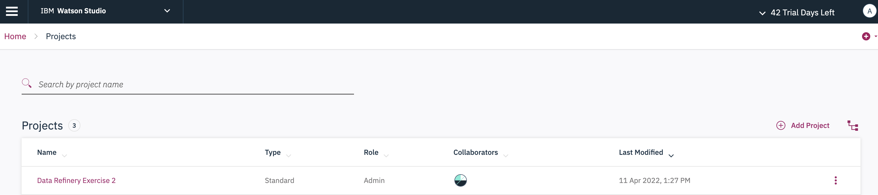
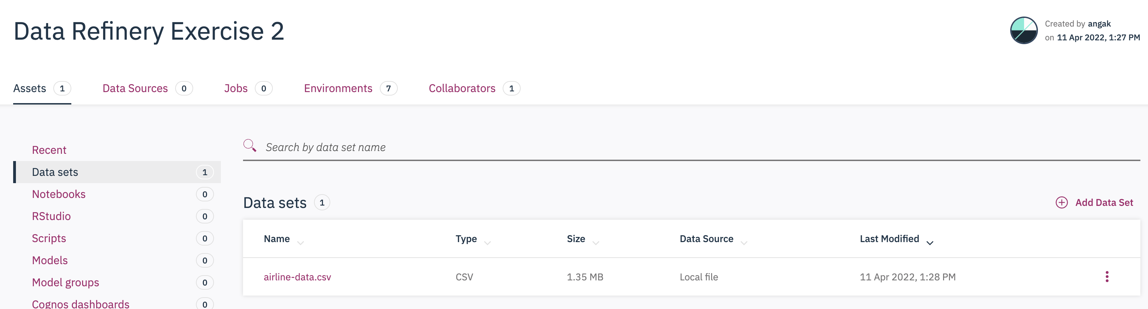
Create a project:
Add dataset : <airline-data.csv>

Slide 24
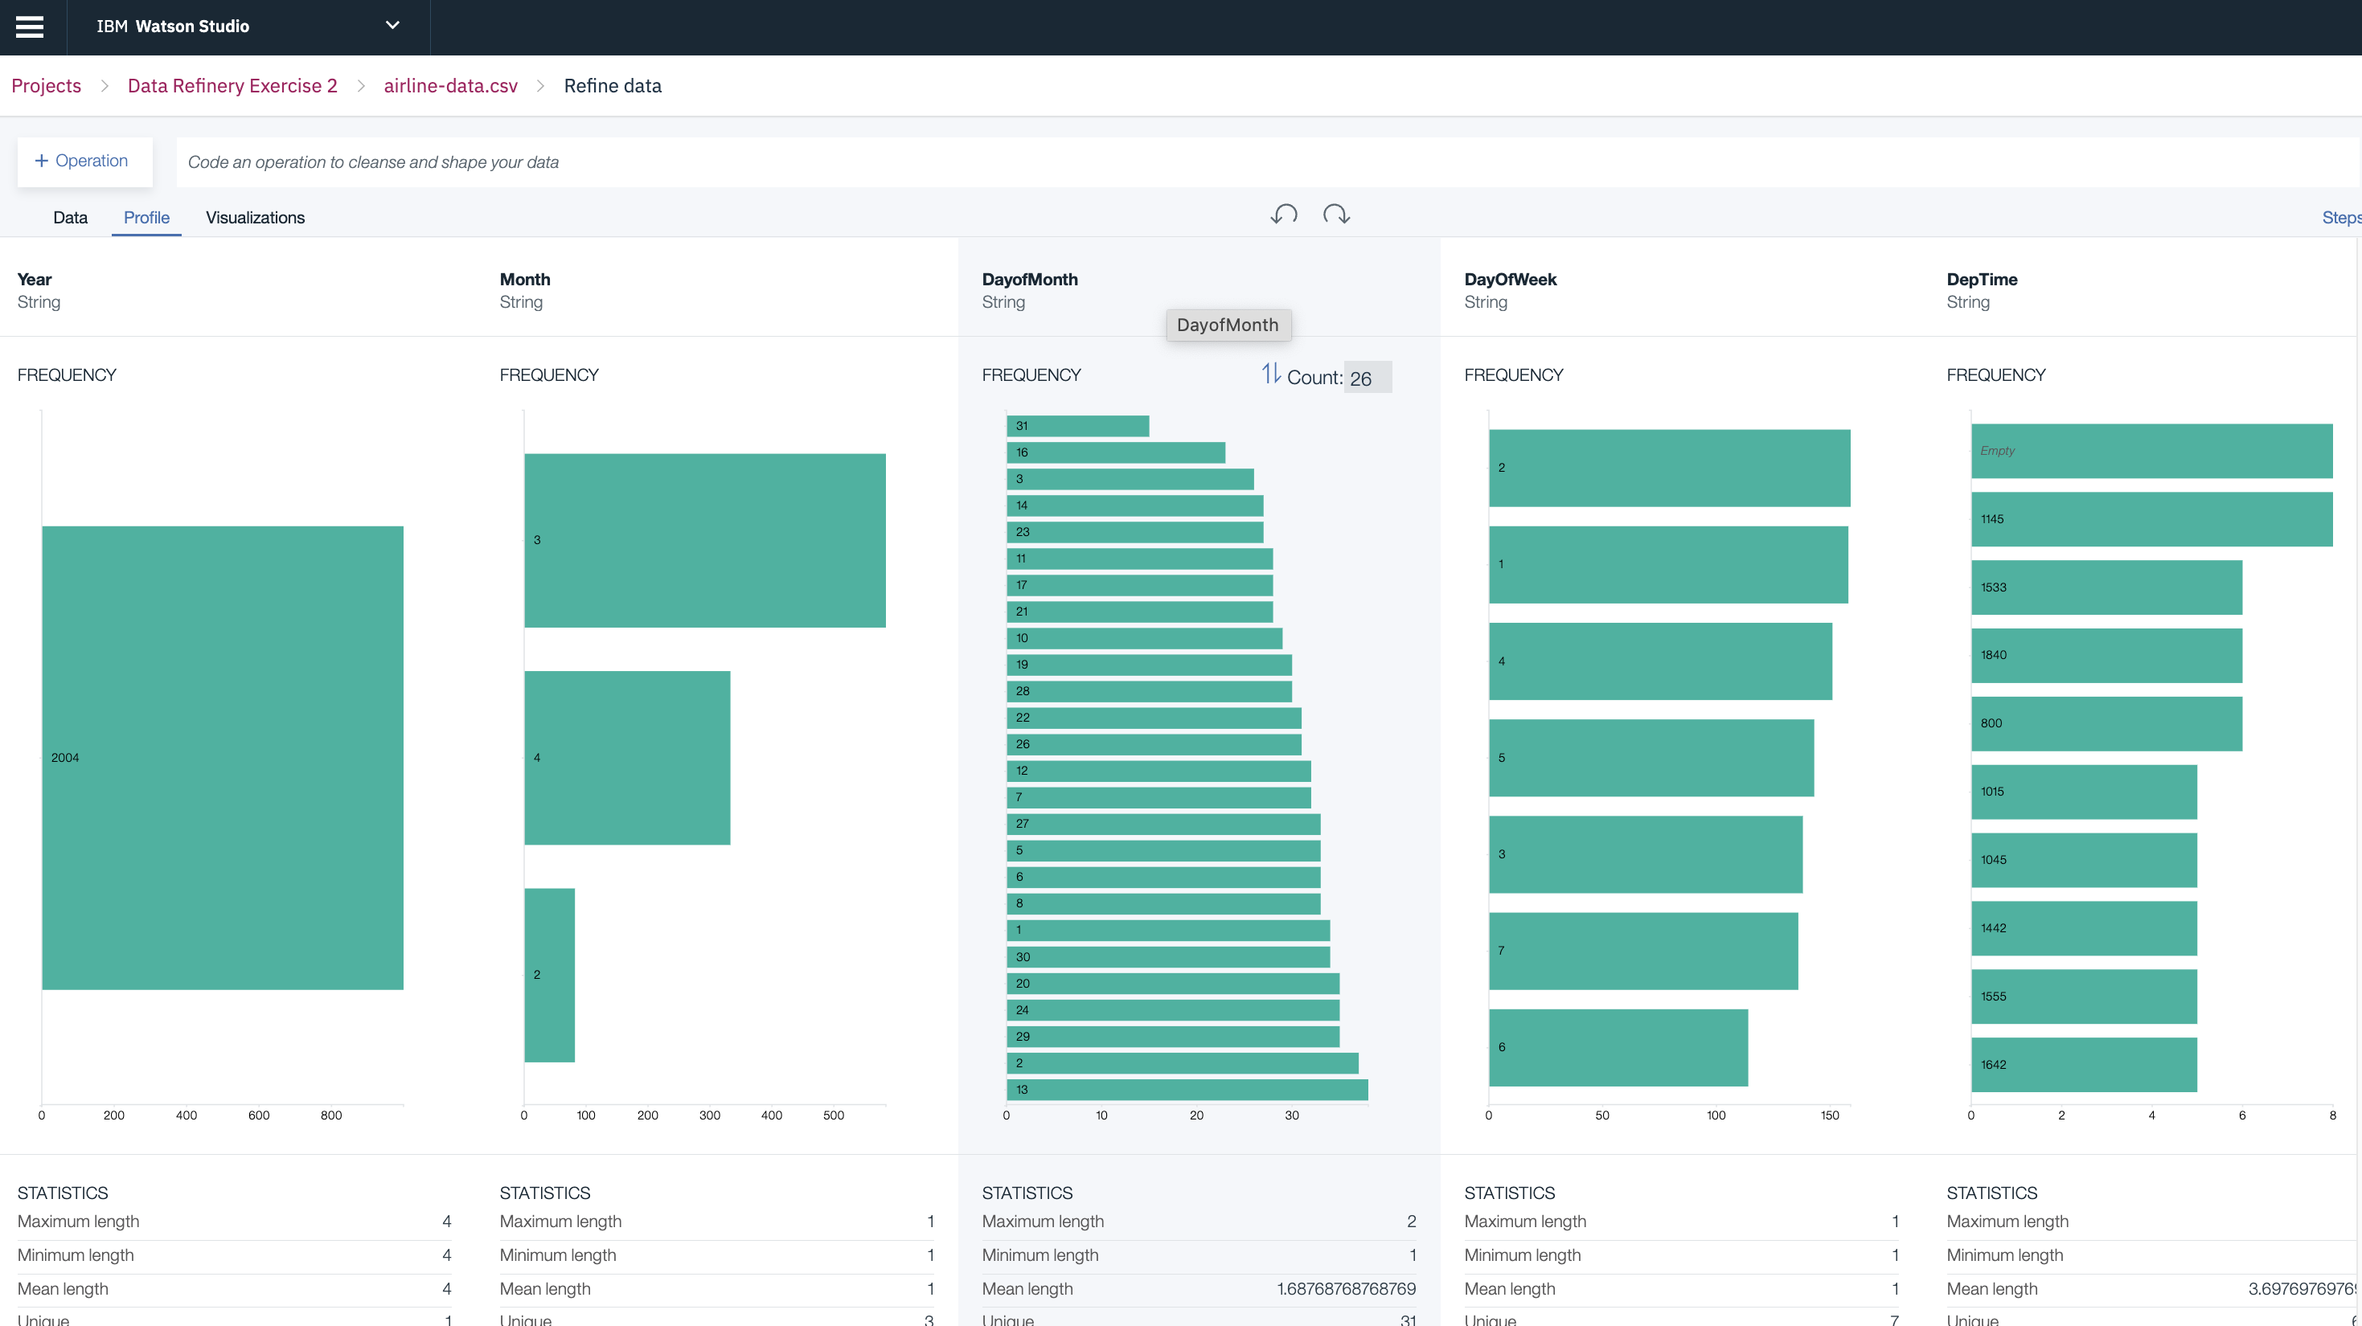
Review Data Profile

Slide 25
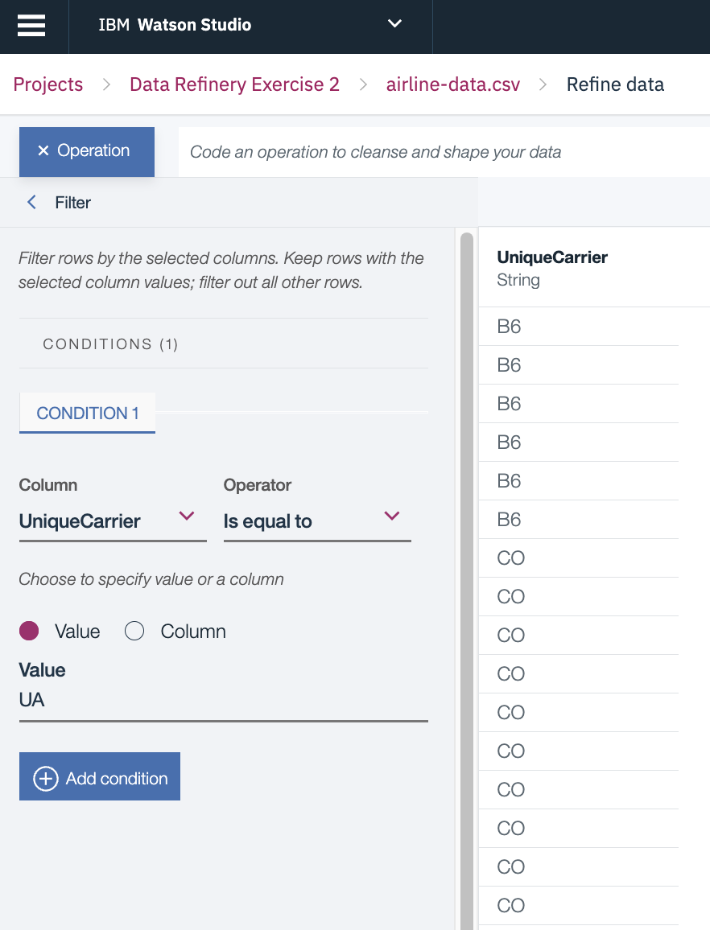
Task 1 : Select only Unique Carrier : United Airlines (UA)
Choose the UniqueCarrier column.
For Operator-> Filter->choose Is equal to.
For Value, enter the string for the airline for which you want to see delay information. For example, UA.

Slide 26
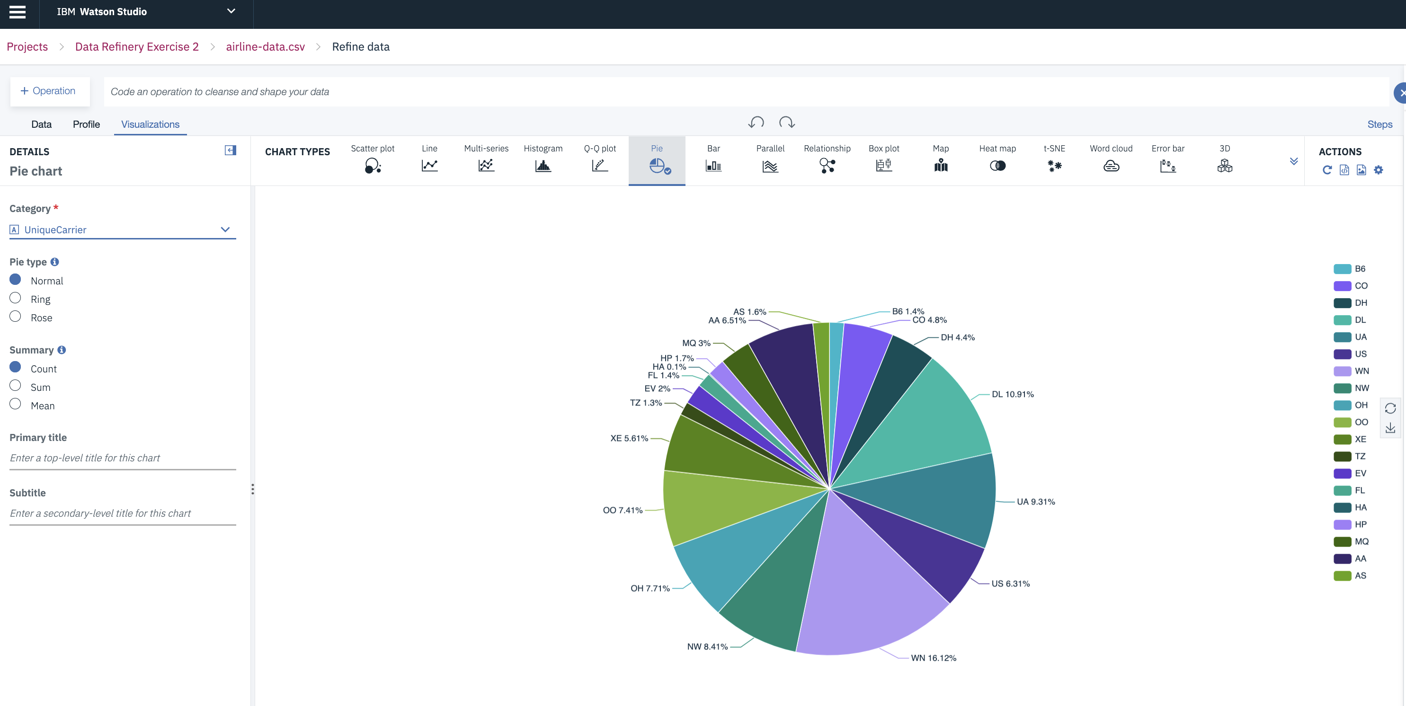
Data Visualization

Slide 27
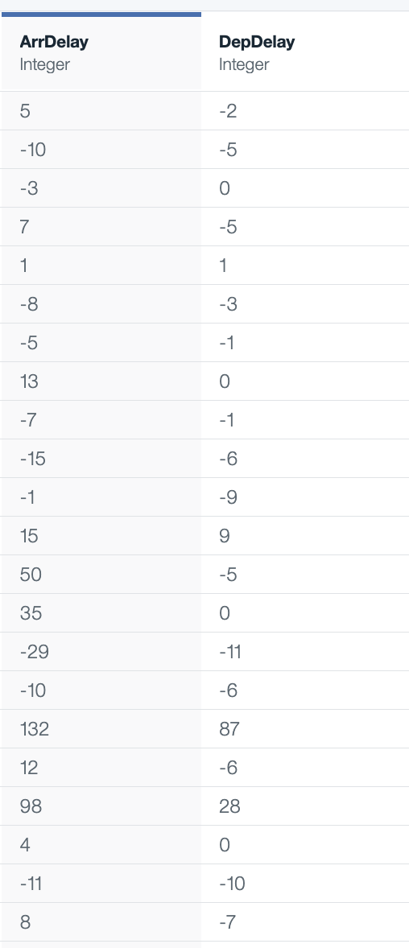
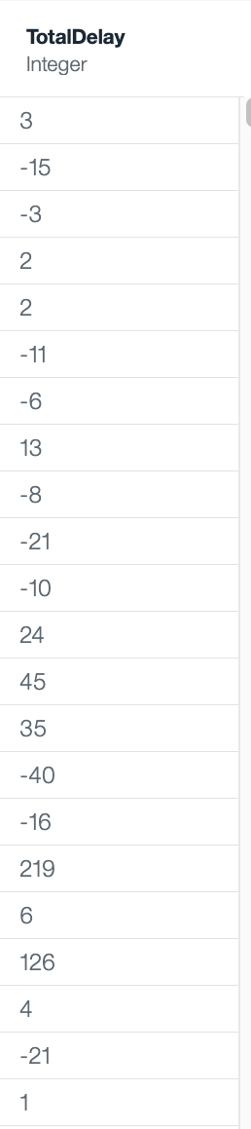
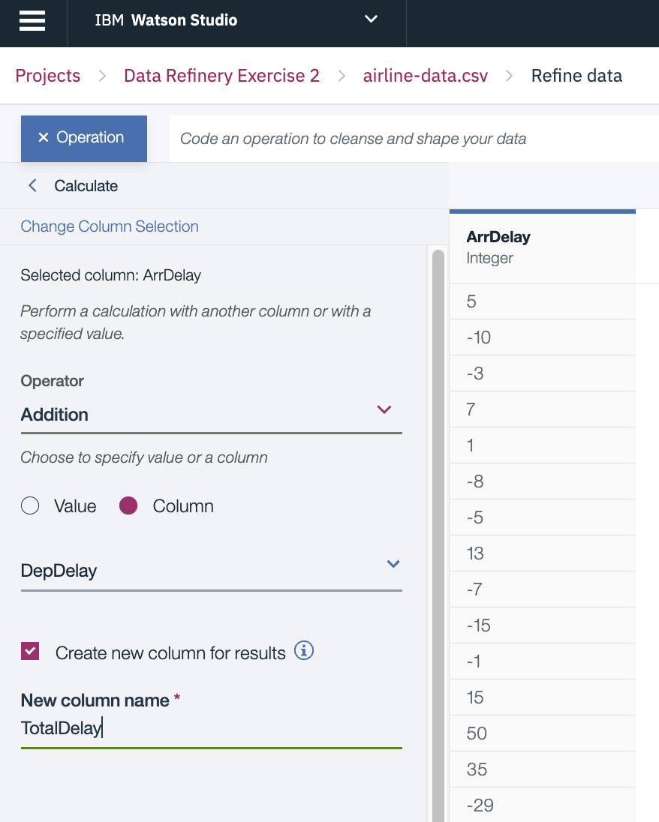
Task 2: Create a new column that adds the arrival and departure delay times together.
The Convert column type operation was automatically applied as the first step to convert the String data types in all the columns whose values are numbers to Integer data types.
Click New step, and then choose the GUI operation Calculate.
Choose the ArrDelay column, and click Next.
For Operator, choose Addition.
Specify "Column", then choose the DepDelay column.
Select Create new column for results.
For New column name, enter TotalDelay.

Slide 28
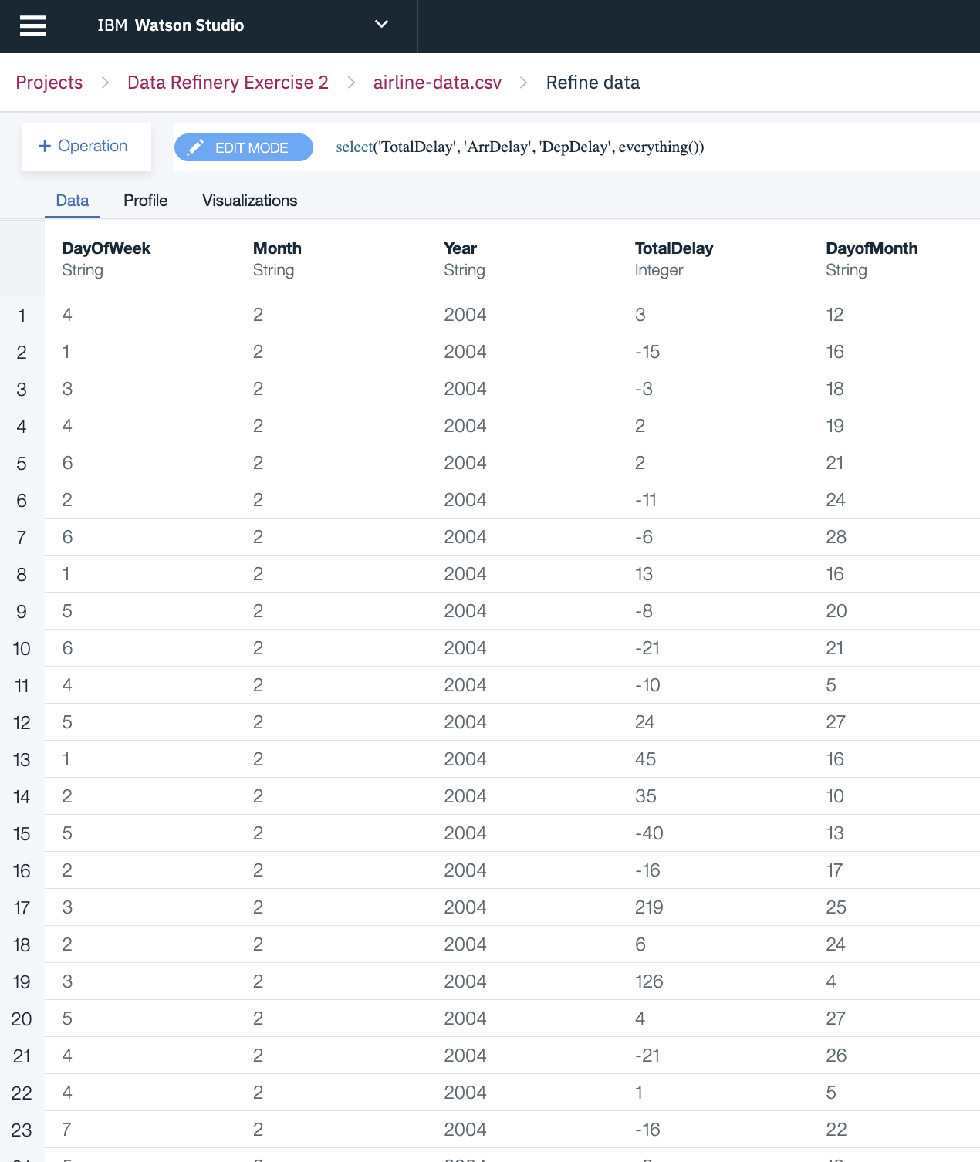
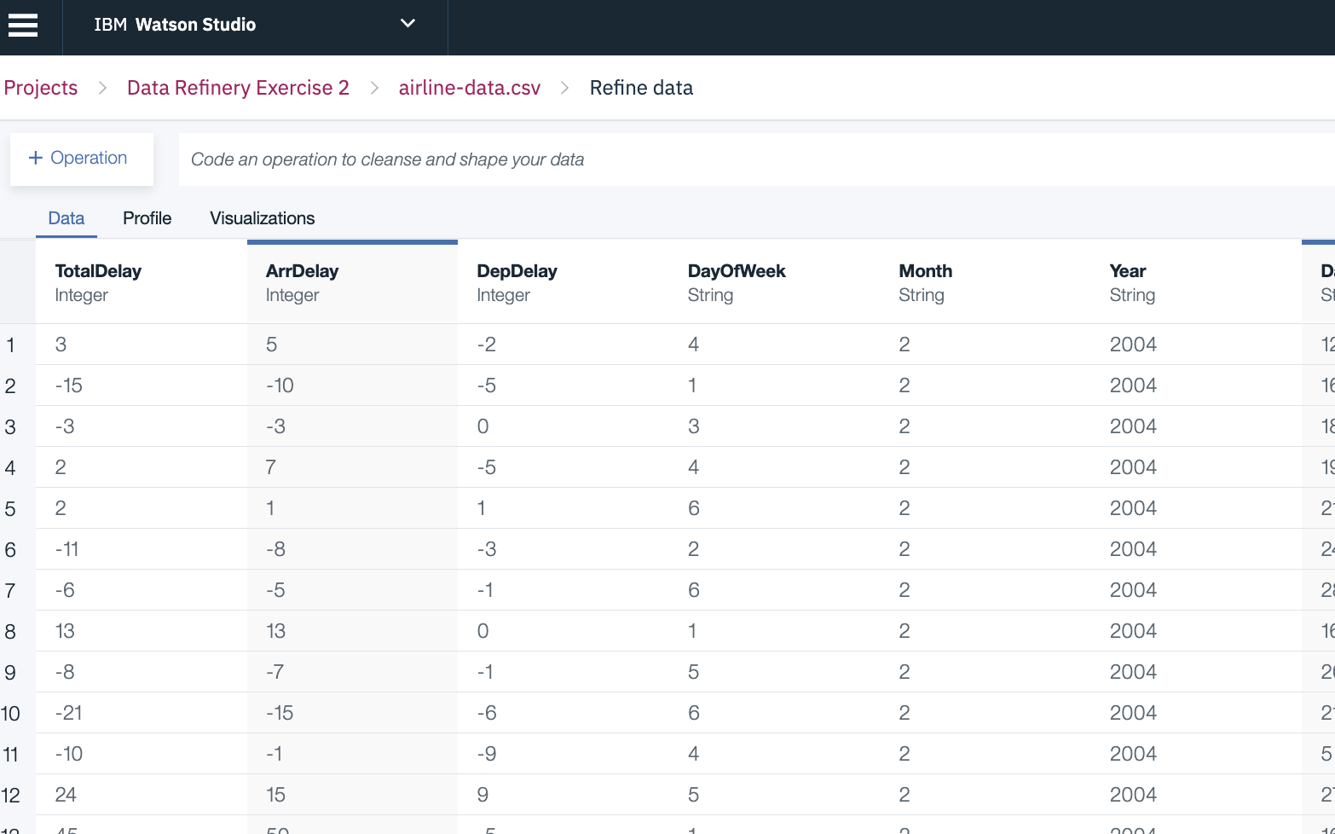
Task 3 : Move the new TotalDelay column to the beginning of the data set
select(`TotalDelay`, everything())

Slide 29
Task 4: Reduce the data to four columns: Year, Month, DayofMonth, and TotalDelay. Use the group_by coding operation to divide the columns into groups of year, month, and day.
In the command-line text box, choose the group_by operation.
Click <column>, and then choose the Year column.
Before the closing parenthesis, type: ,Month,DayofMonth
When you finish, the command should look like this:

Slide 30
Exercise 4 : Titanic dataset
Task 1: columns that are converted to integer are Survived, PClass, Sibsp and Parch. The columns are converted to decimanl are Age and Fare.
Task 2: The columns that have missing values in Titanic dataset are Age, Cabin and Embarked.
Replace missing data in Embarked with S
For Cabin attribute, since tracing the actual cabin for each passenger is impossible. Handling this attribute by creating additional column that has 1 for a passenger who's cabin exists and 0 if it does not exist. Relating to the accident, known passenger's cabin indicate that they survived. To do that follow the below steps:
For age attribute, calculate the mean of the column values and placing it in the null values. To replace missing values by the mean of the column, do the following:
Task 3: Titanic data set does not have sensitive information that should be unique except for the passenger ID. Simply select the Action menu in Passenger Id column and choose Remove duplicates.

Slide 31
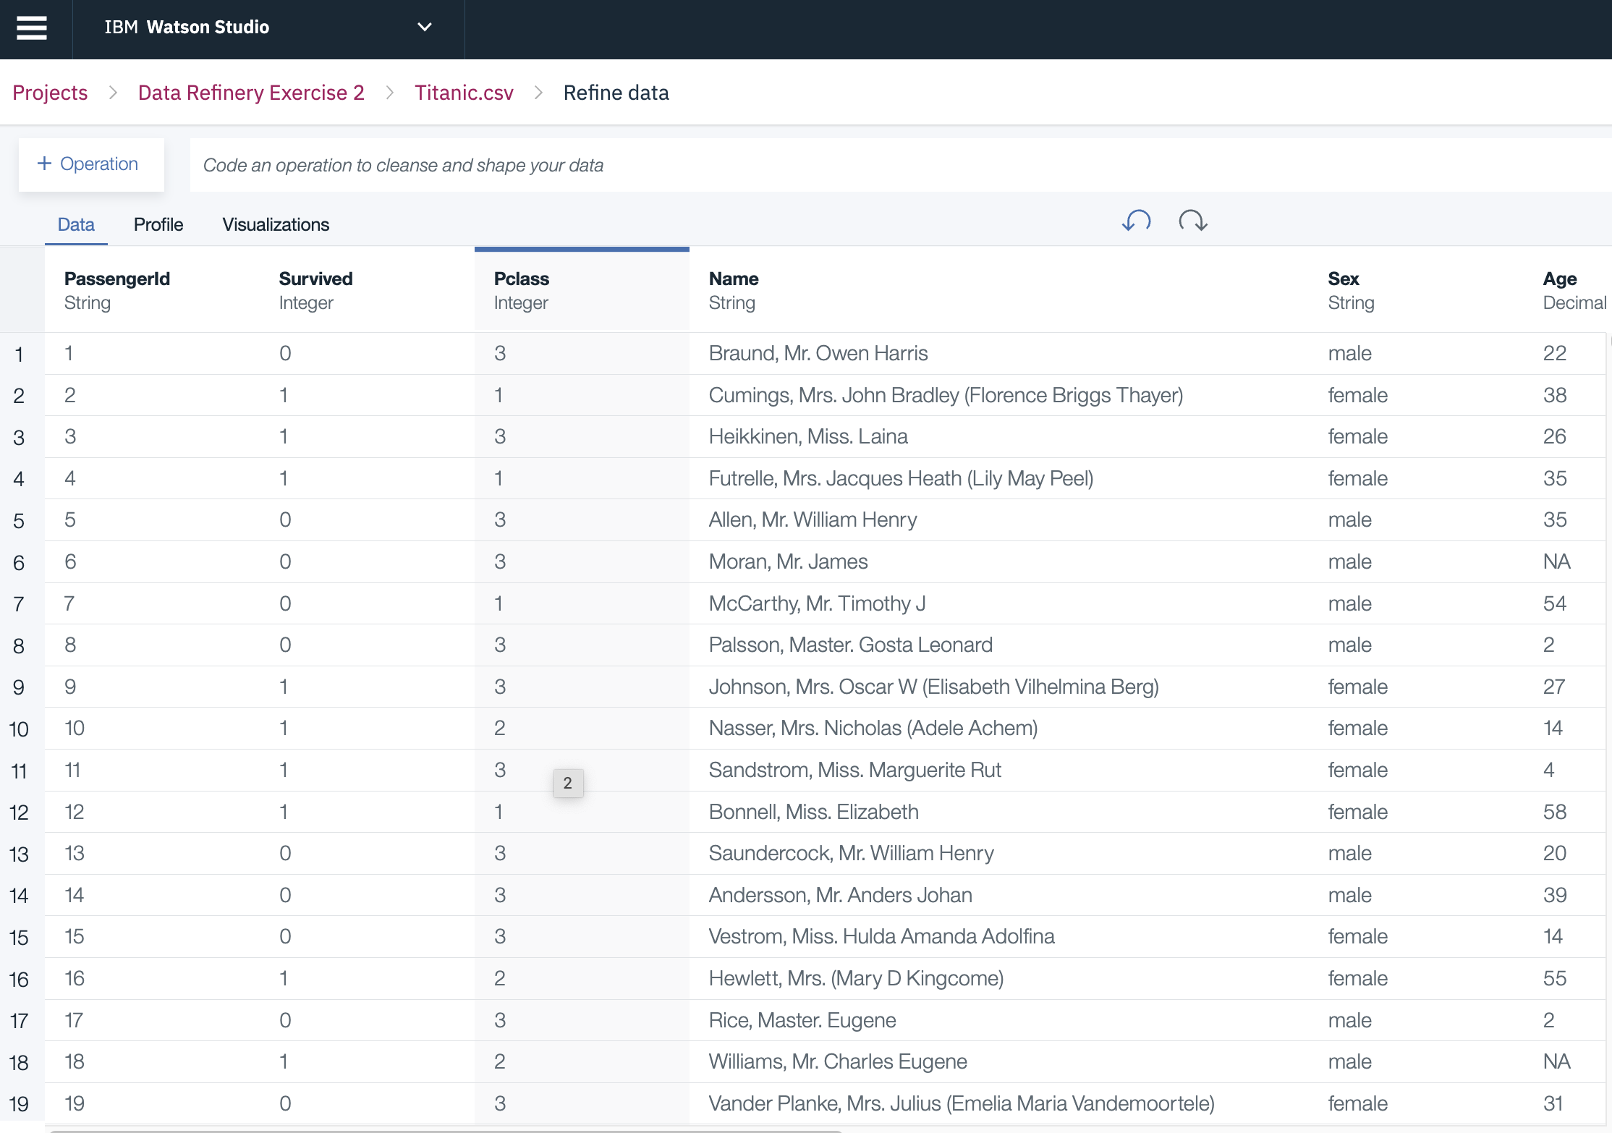
Exercise 4 Task 1: Convert Column Type The columns that are converted to integer are Survived, PClass, Sibsp and Parch The columns are converted to decimanl are Age and Fare.

Slide 32
Task 2: Missing Value The columns that have missing values in Titanic dataset are Age, Cabin and Embarked. The methods to fulfill the missing values are different for each attribute depending on the purpose of the attribute.
Embarked : All passengers actually embarked at Southampton
Cabin : since tracing the actual cabin for each passenger is impossible. Handling this attribute by creating additional column that has 1 for a passenger who's cabin exists and 0 if it does not exist. Relating to the accident, known passenger's cabin indicate that they survived
Age: For age attribute, calculate the mean of the column values and placing it in the null values. To replace missing values by the mean of the column, do the following:
a. Select Conditional Replace
a. Select Conditional Replace
b. Add two conditions in Cabin's column, if value empty replace it with 0, if not empty replace with 1.
Select column Age and Is not empty under operator for the Filteration condition.
From the Operation Bar, select Summarize operator.
Fill in the operation command the required variables like this Summarize(newVarName=operator(column))
summarize(newAge= mean(``Age``))
d. Copy the geneated value to use after, and undo last two action from the backward arrow above. Since the filteration and the new summerized value is now useless.
e. Select Age column again, from the Action menu choose Replace missing values
f. Insert the mean value to be replaced with and press Apply button.

Slide 33
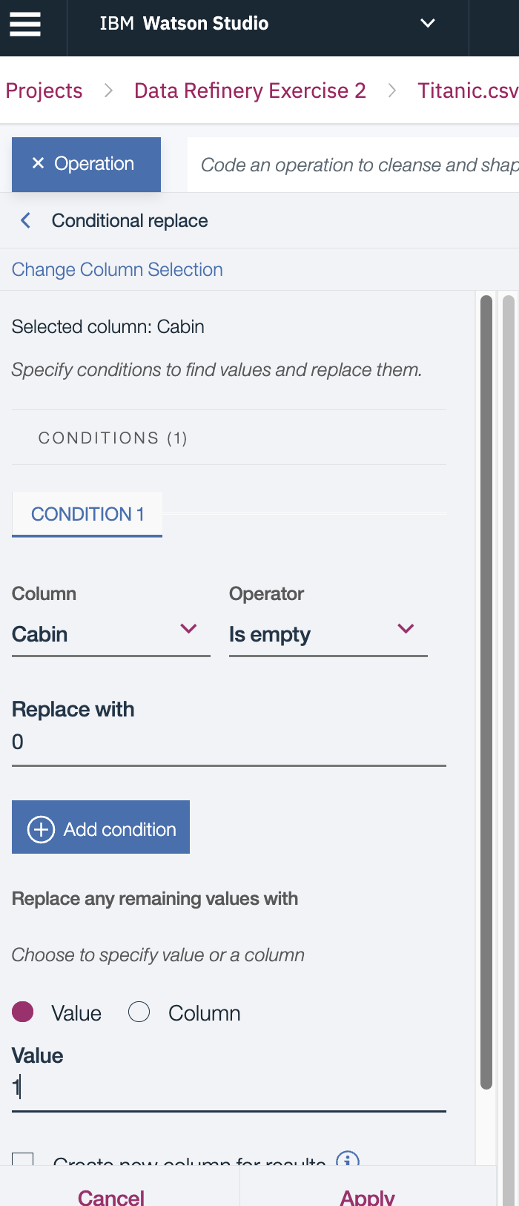
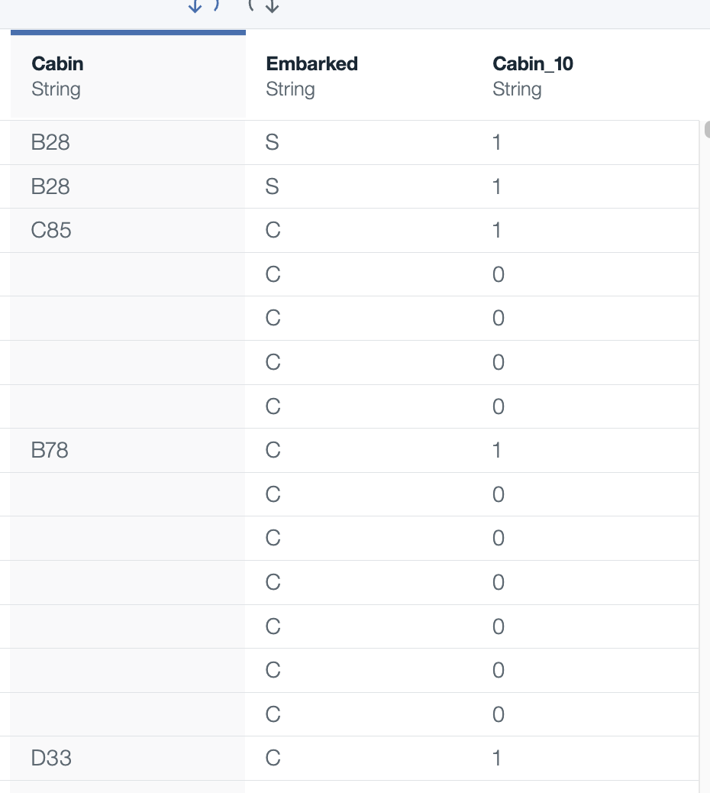

Slide 34
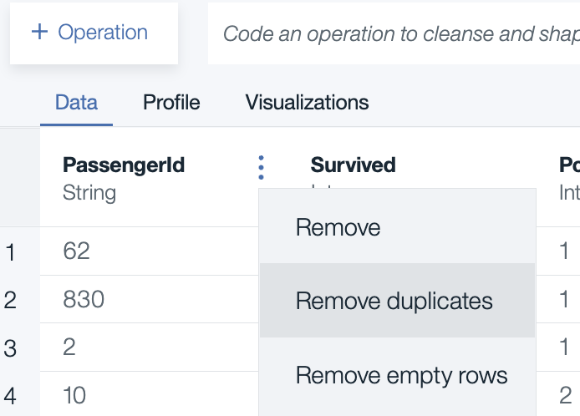
Task 3: Remove duplicate Titanic data set does not have sensitive information that should be unique except for the passenger ID

